Slide 1
DataCamp Introductory Python Course
Utilizing DataCamp Light for interactive CSC101 lessons
By: Matthew Hancock and Rachel Burk

Slide 2

Client/Client Needs
Dr. Harold Nelson
requested supplemental material for an introductory programming class: CSC101

Slide 3
Literature Review
University of Colorado: Center for Faculty Development
Explored Objective Development
Learning Objective
Provides a clear purpose for students to focus their learning efforts
Measurable and observable
Learning Goals
Hope to accomplish
Are not result measurable or observable

Slide 4

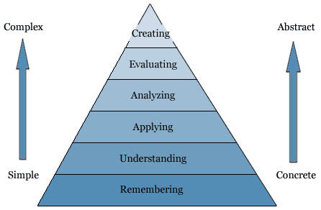
Learning Objectives and Course Design
Multichoice, Multichoice with Console, Console Questions
Remember: recognizing or recalling relevant knowledge, facts or concepts
Understand: constructing meaning from instructional messages
Apply: using ideas and concepts to solve problems
Analyze: breaking something down into components, seeing relationships and overall structure
Evaluate: making judgments based on criteria and standards
Create: reorganizing diverse elements to form a new pattern or structure
Bloom’s Taxonomy
Notes:
How we applied our literature review was in implementing learning objectives and designing course material
Multichoice, with console, and console: chosen for simplicity and emphasis on the following… the ultimate goal was to be able to create working programs with concepts covered in class

Slide 5
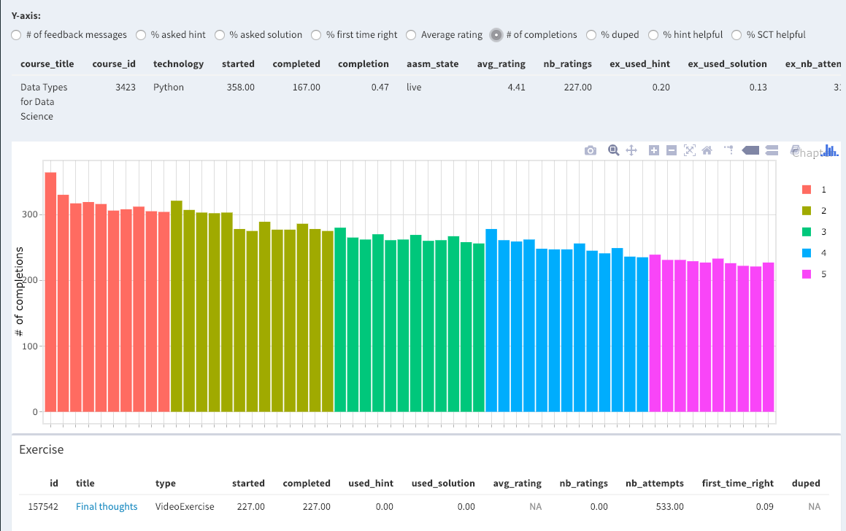
Learning Objectives
DataCamp offers the Content Quality Dashboard
Ability to measure success of the course
Track hints used, attempts, first time right, etc…
Will help improve future material development and maintenance

Slide 6
Challenges
Skill level of incoming students
Preparing students for future Saint Martin’s programming requirements
Submission Correctness Test (SCT) Syntax
Robust and helpful tests and feedback
Time management and balancing school load

Slide 7
Process:
Generating material outlines
Using material outline to create course progression/ blueprints
Establish Learning Objectives as guidelines
Creating material and problems
Accurate solution testing (SCT)
Apply course to the classroom
Earliest application of course will be next semester
https://instructor-support.datacamp.com/courses

Slide 8
Console Features
Multi-Choice Features
Context
Instructions
Hints
Pre-Existing Code
Solution
Sample Code
Submission Correctness Test (SCT)
Question
Hint
Possible Choice
Feedback

Slide 9
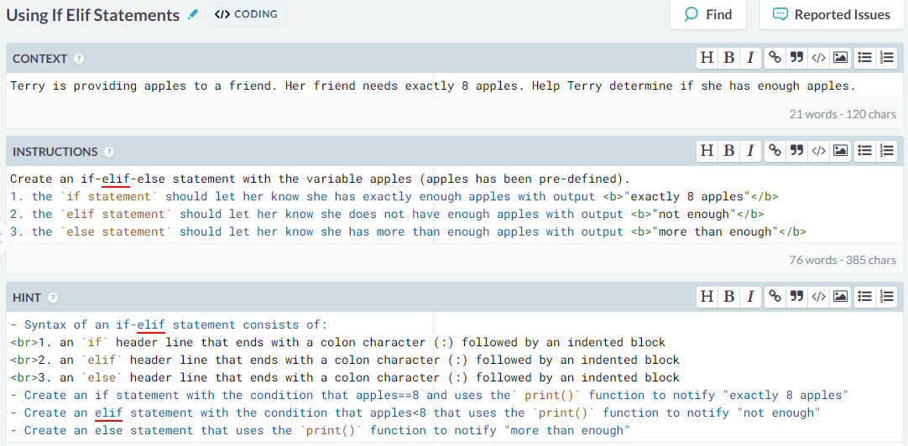
Console Exercise

Slide 10
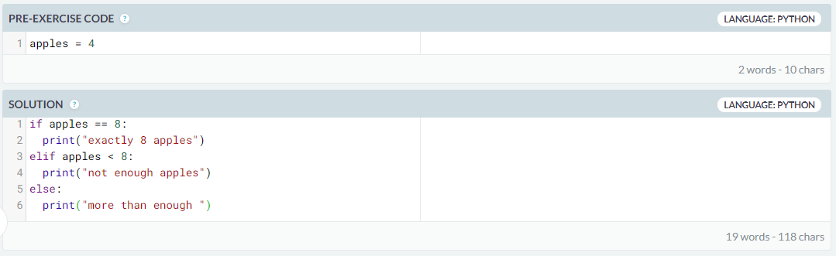
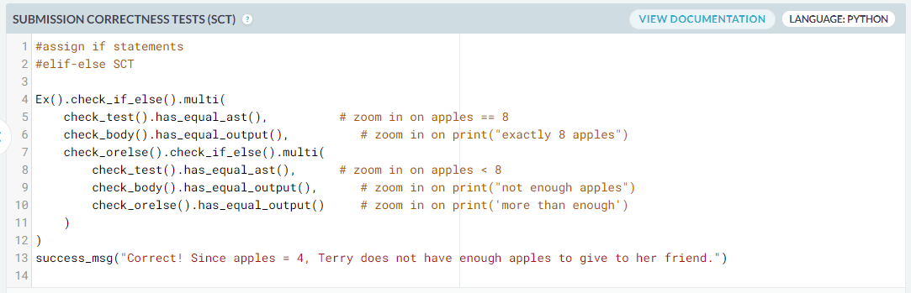
Console Exercise

Slide 11
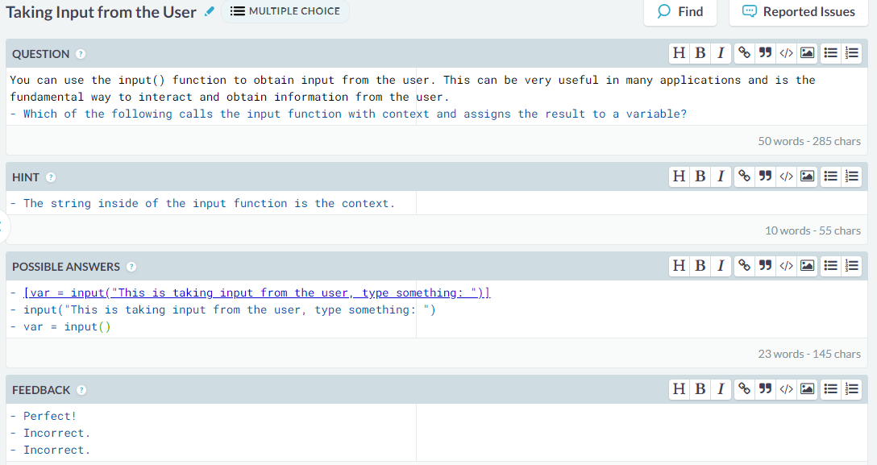
Multiple Choice

Slide 12
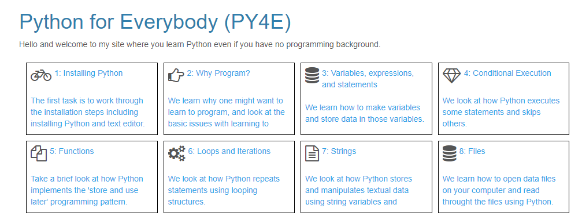
Item | Scheduled Due Date
Module 1: Brief Intro to Python & DataCamp | Week 1: 8/26 – 8/30
Module 2: Variables, Expressions and Statements | Weeks 2 & 3: 9/2 – 9/13
Module 3: Conditional Execution | Weeks 4 & 5: 9/16 – 9/27
Module 4: Functions | Weeks 6 & 7: 9/30 – 10/11
Intermediate Presentation | Weeks 8 & 9: 10/14 – 10/25
Module 5: Iteration | Weeks 10 & 11: 10/28 – 11/8
Module 6: Strings | TBD
Module 7: Files | TBD
Final Presentation | Week 15 (Finals): 12/9 – 12/12

Slide 13
Completed Chapters
Chapter 2: Variables, expression and statements. In this module we will be covering the basics of programming languages. A large focus is on values, types, variables and operators. We will also cover the computer used order of operations to make sense of the code.
Chapter 3: Conditional Execution. Introduce Boolean Expressions and Logical Operations. We will also cover conditional execution and different kinds of conditionals.
Chapter 4: Functions. Introduce how to call and declare functions. Discuss and explain the definition of a function and its uses in programming.
Chapter 5: Iteration. This chapter will have a focus on iteration and looping. We will introduce the basics of for and while loops as well as the dangers of infinite looping.

Slide 14
SIGCSE 2020 Feedback
Review 1
Results of study should be included
Early stage of development
Review 2
Good addition to SIGCSE program
Relevant work and research
Review 3
Contribution must be stated earlier
Early stage of development, results are not present

Slide 15
Future Work
Will be passed to another senior group to continue
Initial focus should be on results of first section
Improvements
Statistics/Successes
Further research into online learning and implementation

Slide 16
Works Cited:
http://www.ucdenver.edu/faculty_staff/faculty/center-for-faculty-development/Documents/tutorials/Assessment/module2/cognitive_process.htm

